Slide 1
IOT Project
Infinity Glove
CHAMPSAUR Lucas
DAMASSE Thomas
TEAM D – Toka Consulting
Notes:
Hello, presenting ourself

Slide 2
1.
Description of the device
Notes:
We will talk about the idea of our device

Slide 3
THE IDEA
Glove to facilitate people life
Notes:
The idea was to facilitate people life.
It started as a « joke » with a rip off of the Marvel Infinity Gauntlet where u can control anything.
So we wanted the daily task such as turn on/off light to be executed thanks to a finger snap.
We later saw that it was a very difficult to make, so decided that we will just make a contact between our finger.

Slide 4
2.
How does this work ?
Notes:
So how does this work ?

Slide 5
Explanation
Wear glove
Contact between two fingers
Automized tasks (ex: turn on light/heating, open door)
Notes:
Well as i said earlier the gist of it is quite simple.
Put the glove on your, make a contact between your thumb and one of the other finger, and an automized task will be executed.
Simple as that.
But to explain a little bit, we used two esp32, one connected to our glove and the other one controlling the automized task.
And as one of our finger touch the thumb this create an information that is sent to the other esp32 to tell him to active or desactivate the task.
We will explain with what kind of connection we made it work.
And, For today this a proof of concept, so we will just control two different light led, but idea is that we can control different thing.

Slide 6
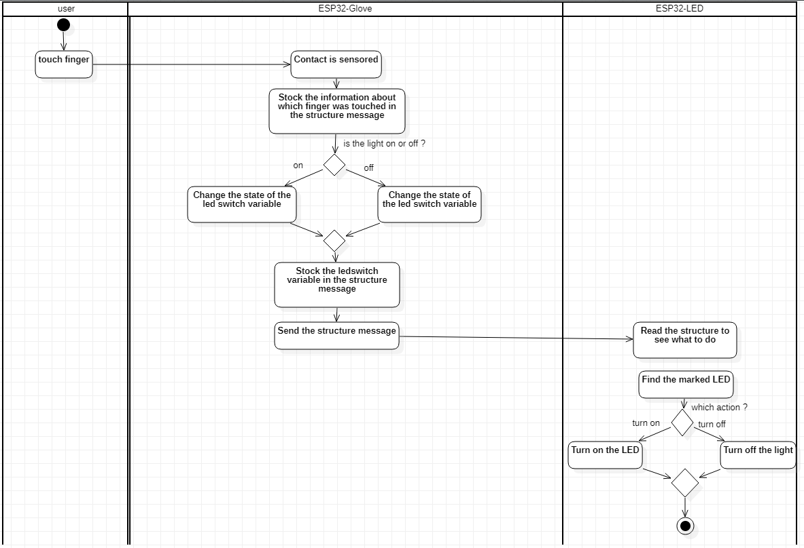
SYSTEM FUNCTIONMENT

Slide 7
3.
Presentation VIDEO

Slide 9
4.
Technical Aspect

Slide 10
COMPONENTS
2x ESP32
Wires
LEDs
1x Glove
Resistors (330 Ohm)
1x Breadboard
Aluminum
Cardboard and tape

Slide 11
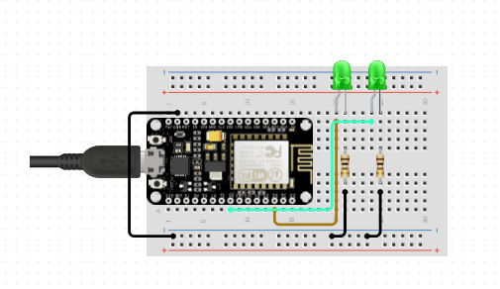
Schematics
GLOVE
EXTERNAL ESP32
Wires directly linked to the fingers (thumb to GND)
ESP32
ESP32

Slide 12
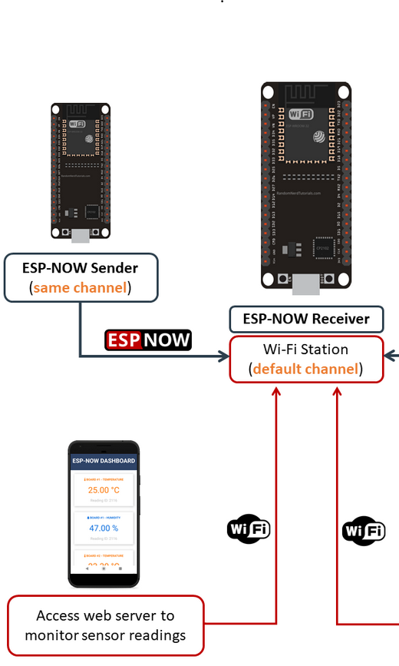
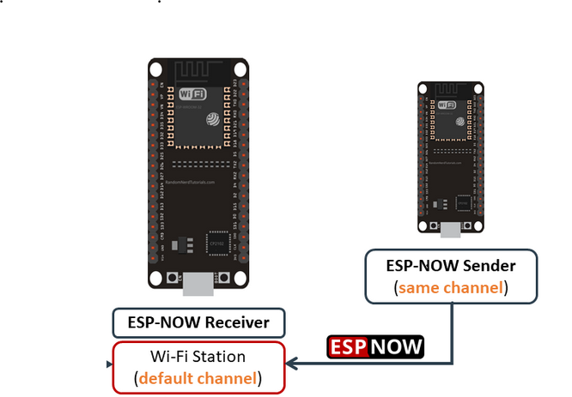
Technology used
ESP NOW
To connect the two ESP 32 together
Allows to send the information
ESP 32 Wifi
Connection to server
Retrieve data

Slide 13
CODE EXplanation
Glove ESP 32
External ESP32
Arduino Part
Define the structure of a message (ledSwitch, readingId, led)
Functions to find the channel of the receiver, to detect if fingers are touching, to know if the data has been delivered
Setup(): connect to the receiver, initialize data
Loop(): send correct data (switch), know if the data has been sent
HTML Part
Create the interface accessible from our phone (to monitor the commands of the glove)
Make the interface react to the commands of the glove
Arduino Part
OnReceivedData(): actions executed depending on the data received
Setup(): initialize the serial, pinMode(), both AP and STA, call the function "OnReceivedData"

Slide 14
5.
Demonstration

Slide 15
6.
CONCLUSION
Notes:
To conclude this presentation, we can say that with more time. We could have show product that will be closer to our final product.
But I think we showed you a good proof of concept -> the device follows the requirements that were asked.
The creation that we made may or may not be used in the future, who knows ?
But this idea, the essence of the object will be for sure !

Slide 16
Thanks!
"Reality can be whatever I want."
-Thanos
Notes:
So guys thanks to listening to us !

