Slide 1
Connected alarm clock
Iot-2020-efrei-m1-clock

Slide 2
Connected alarm clock
Traditional Alarm Clock
Connected Alarm Clock

Slide 3
Embranchment - equipment
Equipment :
RTC DS3231
Arduino UNO Wi-Fi Rev2
Buzzer
Potentiometer
LCD Displayer
Push Button

Slide 4
Interface – alarmes.jademorin.fr
Illimited number of alarms
Activate or deactivate them as much as you want
Settle an alarm from anywhere for whenever you want

Slide 5
Interface – output
Connection to the server
Collect all the activated alarms
Parse String to format time

Slide 6
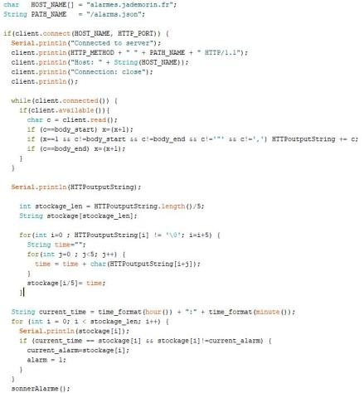
code
Connection to the server
Collect all the activated alarms
Parse String to format time
If an alarm is programmed at current time, the alarm rings

Slide 7
Thank you for your attention !
QUESTIONS ?

