Slide 1
An IoT project by Camille MATHIEU and Timothé CHAUVET

Slide 2
Camille MATHIEU
Timothé CHAUVET

Slide 3
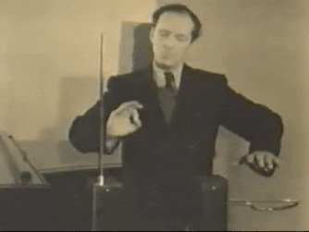
Theremin
What is it ?

Slide 4
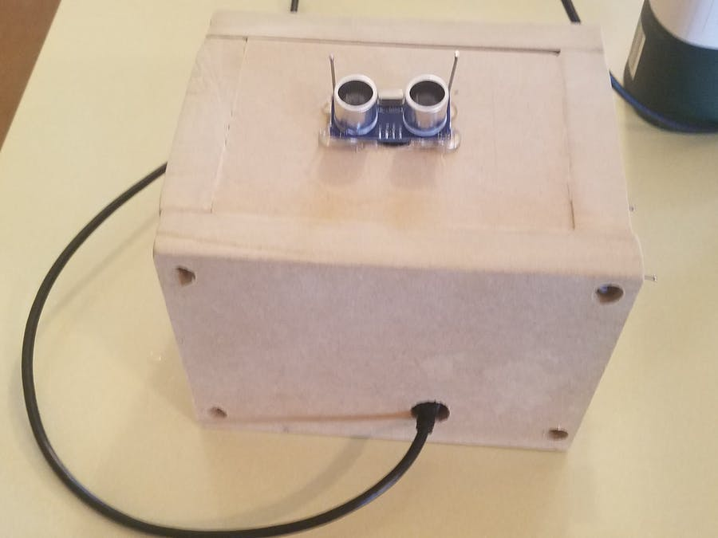
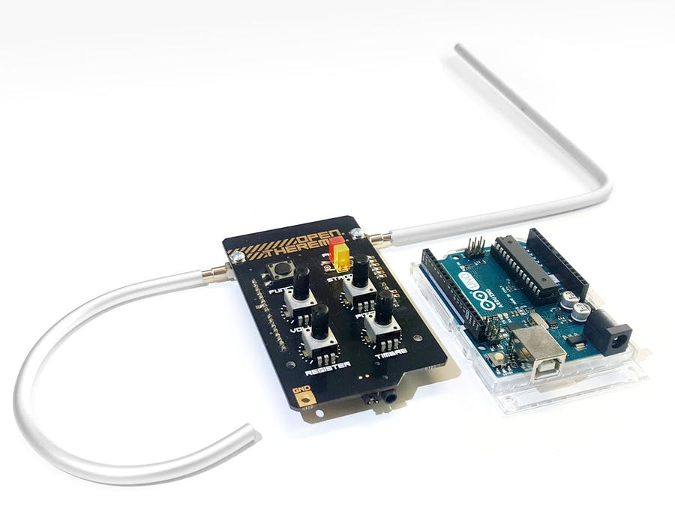
State of the art
Real Theremin Using Open.Theremin Shield for Arduino
Ultrasonic Theremin

Slide 5
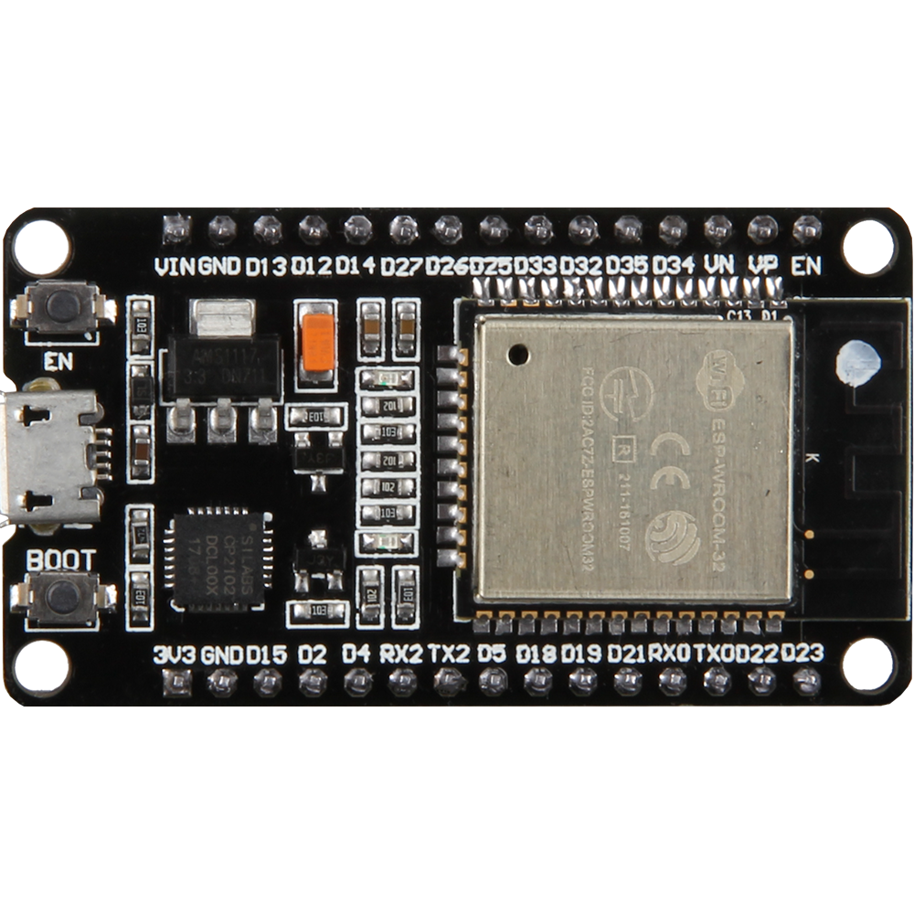
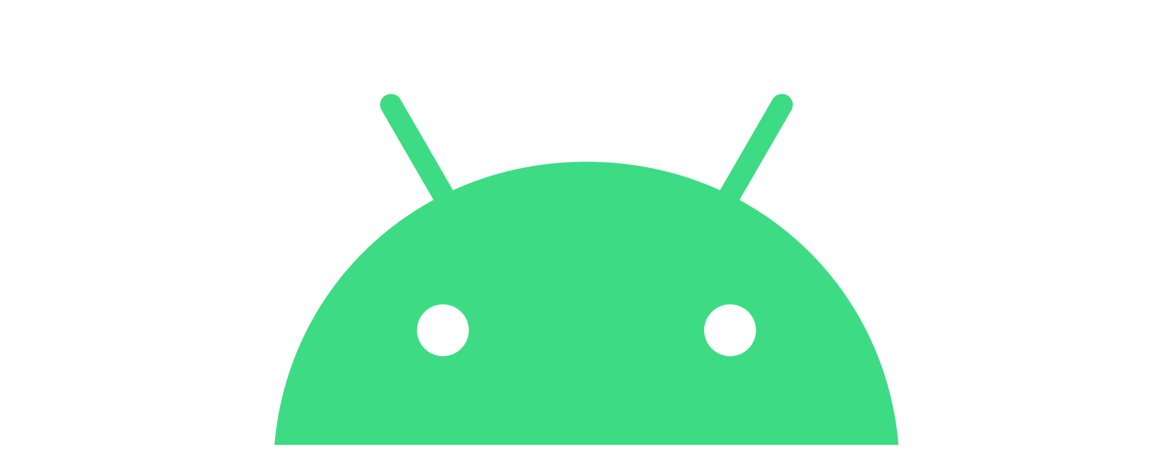
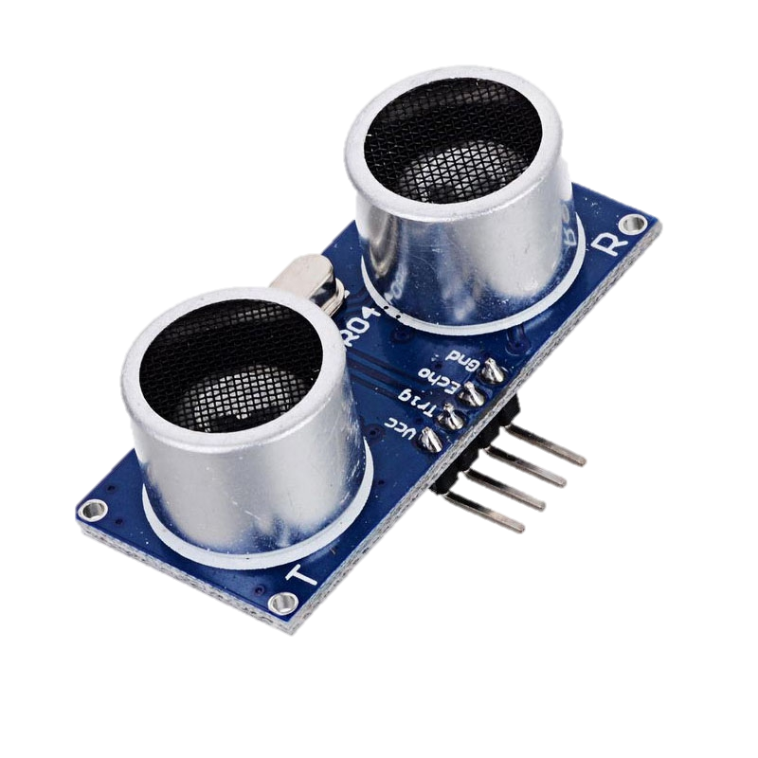
objective
Two sensors to capture volume & frequency
ESP32 sends data to Android
Data converted to sound

Slide 6
Process flow
Ultrasound sent to the hand
Computation of the distance
Data sent to the Android Phone
Sound produced

Slide 7
Camille MATHIEU
Timothé CHAUVET
Arduino
Conception
App
Bluetooth part

Slide 8
What we’ve done

Slide 9
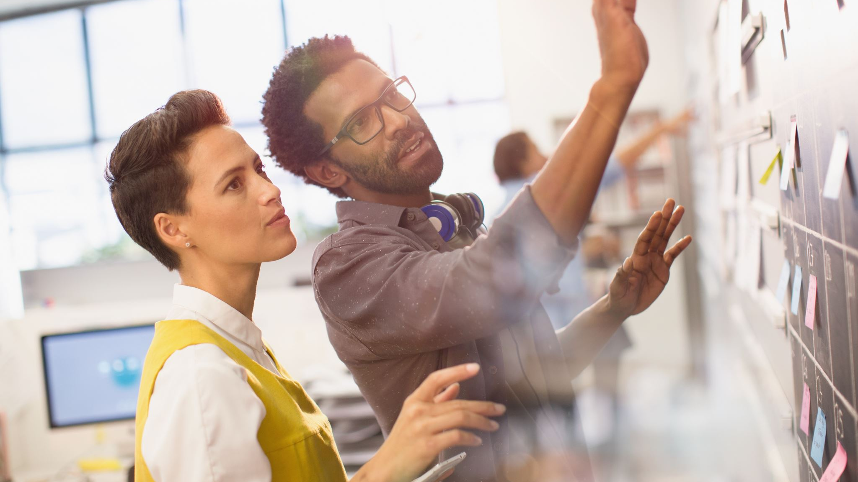
Demonstration of the final project

Slide 10
Future of the project
Connect it to the computer using CMD

